Slide 1
Probability Overview
“A key concept in the field of pattern recognition is that of uncertainty.”

Slide 2
Random Variables
A random variable is a “probabilistic” outcome, such as a coin flip or the height of a person chosen from a population.
The observed value of random variable, depend on some known or unknown probability distribution.
Random values take on values in a sample space. This space may be discrete or continuous.
coin flip{H, T}
height (0,250)
The values of a random variable are called atoms.
For example, X is a coin flip, and x is the value (H or T) of the coin flip.

Slide 3
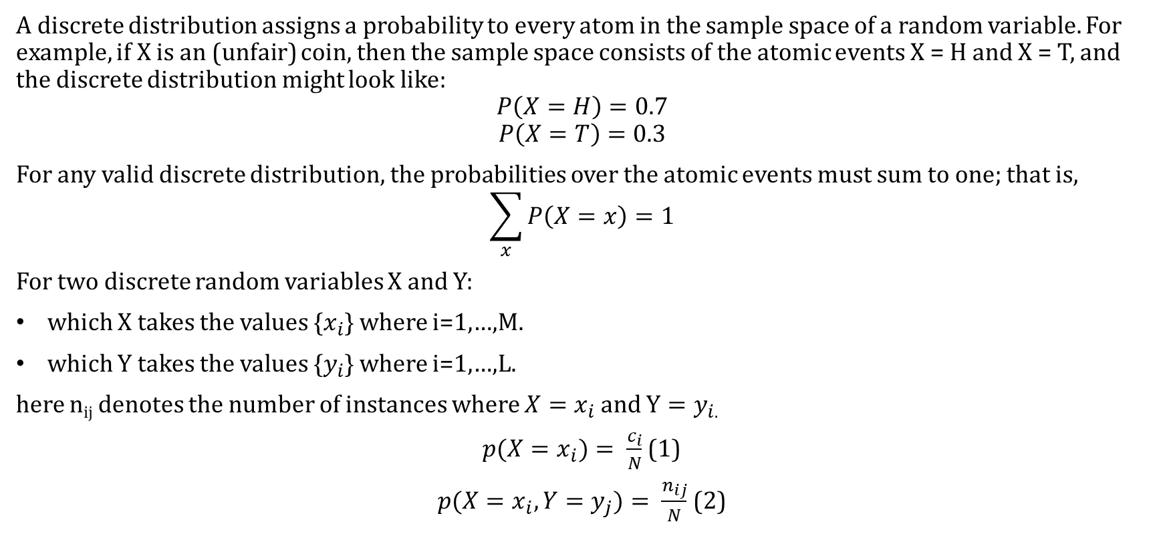
Discrete Distributions
A discrete distribution assigns a probability to every atom in the sample space of a random variable. For example, if X is an (unfair) coin, then the sample space consists of the atomic events X = H and X = T, and the discrete distribution might look like:
$$P\left(X=H\right)=0.7$$
$$P\left(X=T\right)=0.3$$
For any valid discrete distribution, the probabilities over the atomic events must sum to one; that is,
$$\sum_{x}{P\left(X=x\right)=1}$$
For two discrete random variables X and Y:
which X takes the values {$x_{i}$} where i=1,…,M.
which Y takes the values {$y_{i}$} where i=1,…,L.
here n_{ij} denotes the number of instances where $X=x_{i}$and $Y=y_{i}$.
${p(X=x}_{i})= \frac{c_{i}}{N}$ (1)
$p(X=x_{i},Y=y_{j})= \frac{n_{ij}}{N}$ (2)

Slide 4

From (1) and (2) we have Sum Rule of Probability (Marginal Probability):
$p\left(X=x_{i}\right)=\sum_{j=1}^{L}{p({X=x}_{i}|Y=y_{j})}$ (3)
Similarly, we can obtain Conditional Probability:
$p\left(Y=y_{j}|{X=x}_{i}\right)=\frac{n_{ij}}{c_{i}}$ (4)
From (1), (2) and (4) we can obtain Product Rule of Probability (Joint Probability):
$p\left({X=x}_{i},Y=y_{j}\right)=\frac{n_{ij}}{N}=\frac{n_{ij}}{c_{i}}$. $\frac{c_{i}}{N}$
$=p\left(Y=y_{j}|{X=x}_{i}\right)$.P(${X=x}_{i}$) (5)

Slide 5

Rules of probability:
Sum Rule: $p\left(X\right)= \sum_{Y}{p(X,Y)}$
Product Rule: $p\left(X, Y\right)=p(Y|X)p(X)$
Chain rule of probability:$p\left(X_{1:D}\right)=p(X_{1})p(X_{2}|X_{1})$ $p\left(X_{3} | X_{2}X_{1}\right)… p\left(X_{D}|X_{1:D−1}\right)$
Marginalization

Slide 6
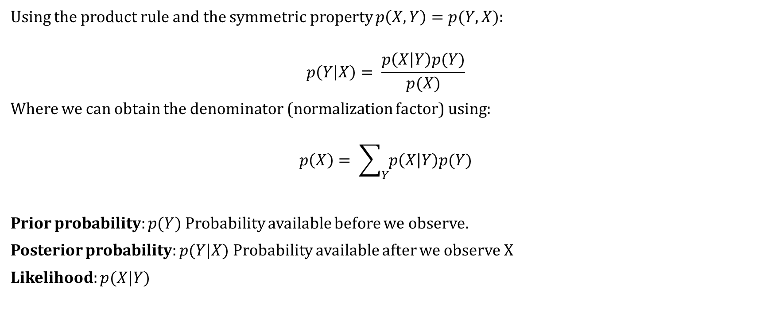
Bayes’ Theorem
Using the product rule and the symmetric property $p\left(X,Y\right)=p(Y,X)$:
$$p\left(Y | X\right)= \frac{p\left(X | Y\right)p(Y)}{p(X)}$$
Where we can obtain the denominator (normalization factor) using:
$$p\left(X\right)= \sum_{Y}{p\left(X | Y\right)p(Y)}$$
Prior probability: $p(Y)$ Probability available before we observe.
Posterior probability: $p(Y|X)$ Probability available after we observe X
Likelihood: $p(X|Y)$

Slide 7
Quiz:
Suppose you are a woman in your 40s, and you decide to have a medical test for breast cancer called a mammogram. You are told that the test has a sensitivity of 80%, which means, if you have cancer, the test will be positive with probability 0.8 and with probability of 0.1 the test might be faulty. You also know that the prior probability of having breast cancer is 0.004.
given the above information if the test is positive, what is the probability you have cancer?

Slide 8
Example: Distribution over two variables

Slide 9
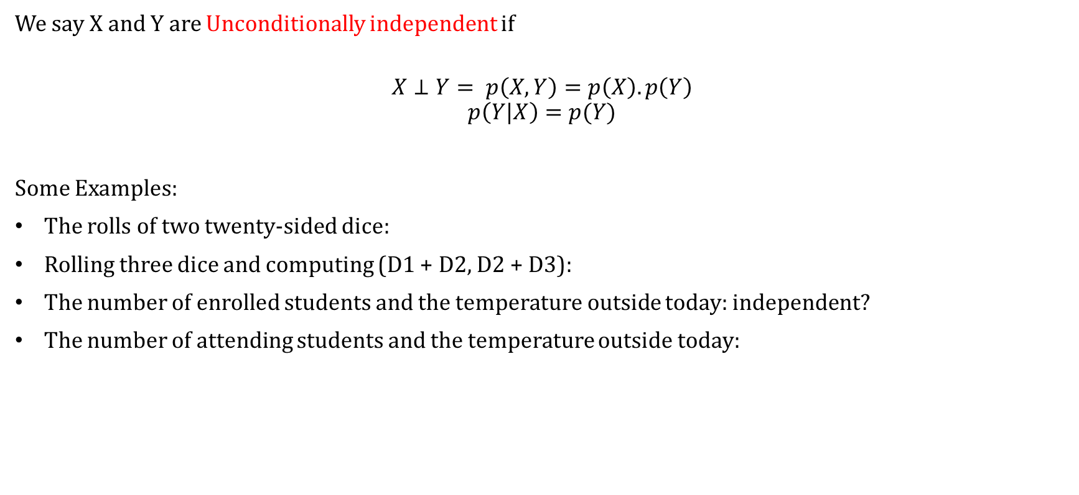
Independent and Conditional Independent
We say X and Y are Unconditionally independent if
$$X⊥Y= p\left(X,Y\right)=p\left(X\right).p\left(Y\right)$$
$$p\left(Y|X\right)=p(Y)$$
Some Examples:
The rolls of two twenty-sided dice:
Rolling three dice and computing (D1 + D2, D2 + D3):
The number of enrolled students and the temperature outside today: independent?
The number of attending students and the temperature outside today:

Slide 10
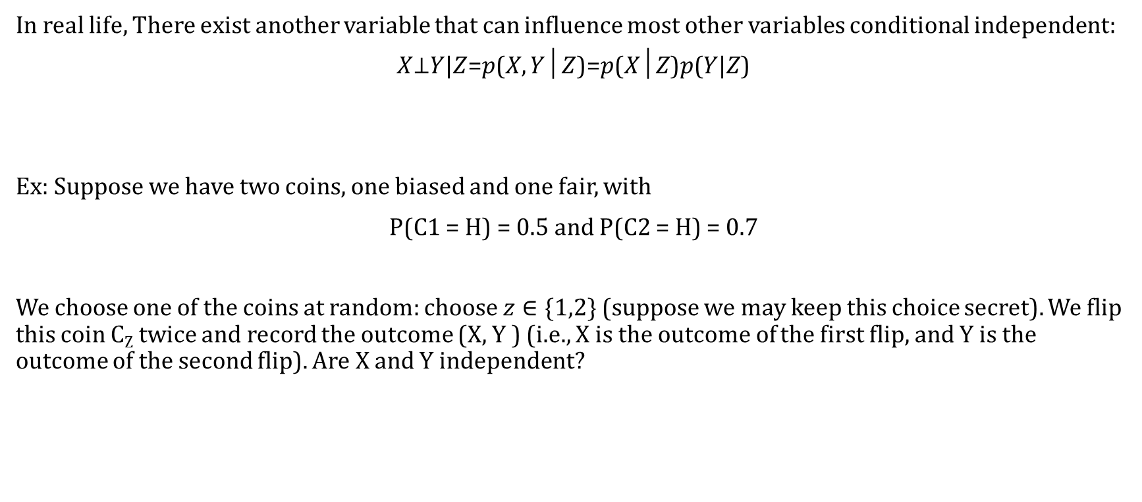
Conditional Independence
In real life, There exist another variable that can influence most other variables conditional independent:
𝑋⊥𝑌|𝑍=𝑝(𝑋, 𝑌│𝑍)=𝑝(𝑋│𝑍)𝑝(𝑌|𝑍)
Ex: Suppose we have two coins, one biased and one fair, with
P(C1 = H) = 0.5 and P(C2 = H) = 0.7
We choose one of the coins at random: choose $z∈\{1,2\}$ (suppose we may keep this choice secret). We flip this coin C_{Z} twice and record the outcome (X, Y ) (i.e., X is the outcome of the first flip, and Y is the outcome of the second flip). Are X and Y independent?

Slide 11
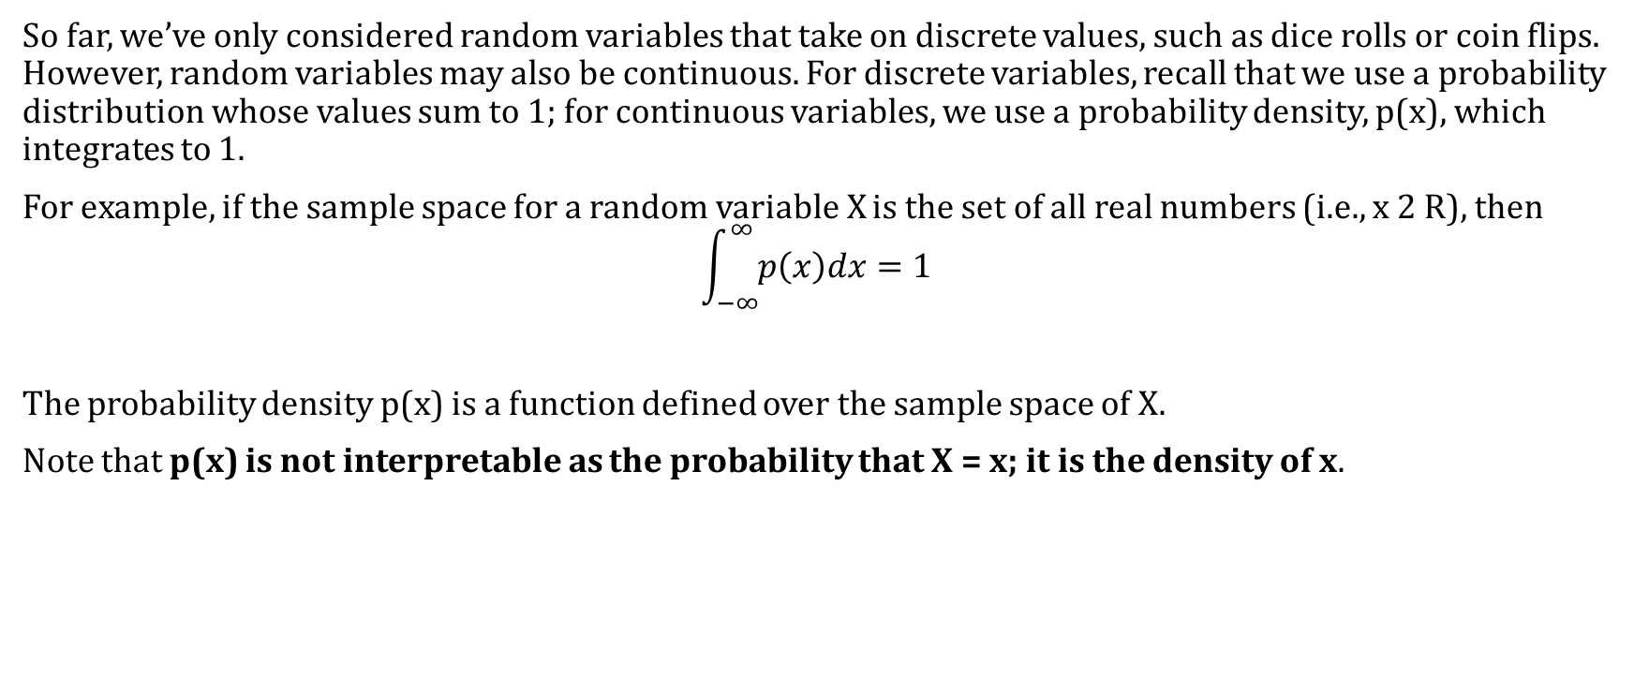
Continuous Random Variables
So far, we’ve only considered random variables that take on discrete values, such as dice rolls or coin flips. However, random variables may also be continuous. For discrete variables, recall that we use a probability distribution whose values sum to 1; for continuous variables, we use a probability density, p(x), which integrates to 1.
For example, if the sample space for a random variable X is the set of all real numbers (i.e., x 2 R), then
$$\int_{−∞}^{∞}{p\left(x\right)dx=1}$$
The probability density p(x) is a function defined over the sample space of X.
Note that p(x) is not interpretable as the probability that X = x; it is the density of x.

Slide 12

Probability Density
If the probability of a real-valued variable x falling in the interval $\left(x, x+δx\right)$is given by $p(x)δx$ for $δx→0$, then p(x) is called the probability density over x.
$$p\left(x∈\left(a,b\right)\right)=\int_{a}^{b}{p\left(x\right)dx}$$
The p(x) should satisfy the two conditions:
$p\left(x\right)≥0$
$\int_{−∞}^{∞}{p\left(x\right)dx=1}$
Cumulative distribution

Slide 13

Cumulative distribution function:
$$P\left(z\right)=\int_{−∞}^{z}{p\left(x\right)dx}$$
Similarly, for the sum and product rules we have:
$$P\left(x\right)=\int{p\left(x,y\right)dy}$$
$$p\left(x,y\right)=p\left(y | x\right)p(x)$$

Slide 14
Expectation
The average value of some function f(x) under a probability distribution p(x) is called the expectation of f(x) and will be denoted by E[f].
For a discrete distribution:
In the continuous case, the expectation is an integral
Conditional expectation:
Variance of variable x:
Covariance of two random variables x and y:

Slide 15
Iterated Expectation

Slide 16
Probability Models
Probability distributions are used as models of data we observe.
Examples of properties we may wish to infer include:
The bias of a coin
The average height of a student
The chance that someone will vote for Hillary Clinton
The chance that someone in Vermont will vote for Hillary Clinton
The proportion of gold in a mountain

Slide 17
Independent and Identically Distributed Random Variables
Independent and identically distributed (or IID) random variables are mutually independent of each other and are identically distributed in the sense that they are drawn from the same probability distribution.
For example:
If we flip the same coin N times and record the outcome, then {X₁, . . . ,X_{N}} are IID. The IID assumption can be useful in data analysis, even when the data is not strictly IID.

Slide 18
The Maximum Likelihood Estimate
Is the value of the parameter that maximizes the log likelihood.
Intuitively, and in some sense mathematically, this is the value that “best explains” our observations.
For example, suppose you flip a coin N times, and its true bias is .

Slide 19
The Gaussian distributions

Slide 20

For the case of a single real-valued variable x, the Gaussian distribution is defined by
Where the:
$$μ=mean$$
$$σ^{2}=Variance$$
$$σ=standard deviation$$
$$precision= β=\frac{1}{σ^{2}}$$
Gaussian distribution should satisfy the following two properties:

Slide 21

expectations of functions of x under the Gaussian distribution:
And
Gaussian distribution over a D-dimensional vector of x:
Where:
$$D−dimensional vector μ is called mean$$
$$D×D matrix Σ is called covariance$$

Slide 22
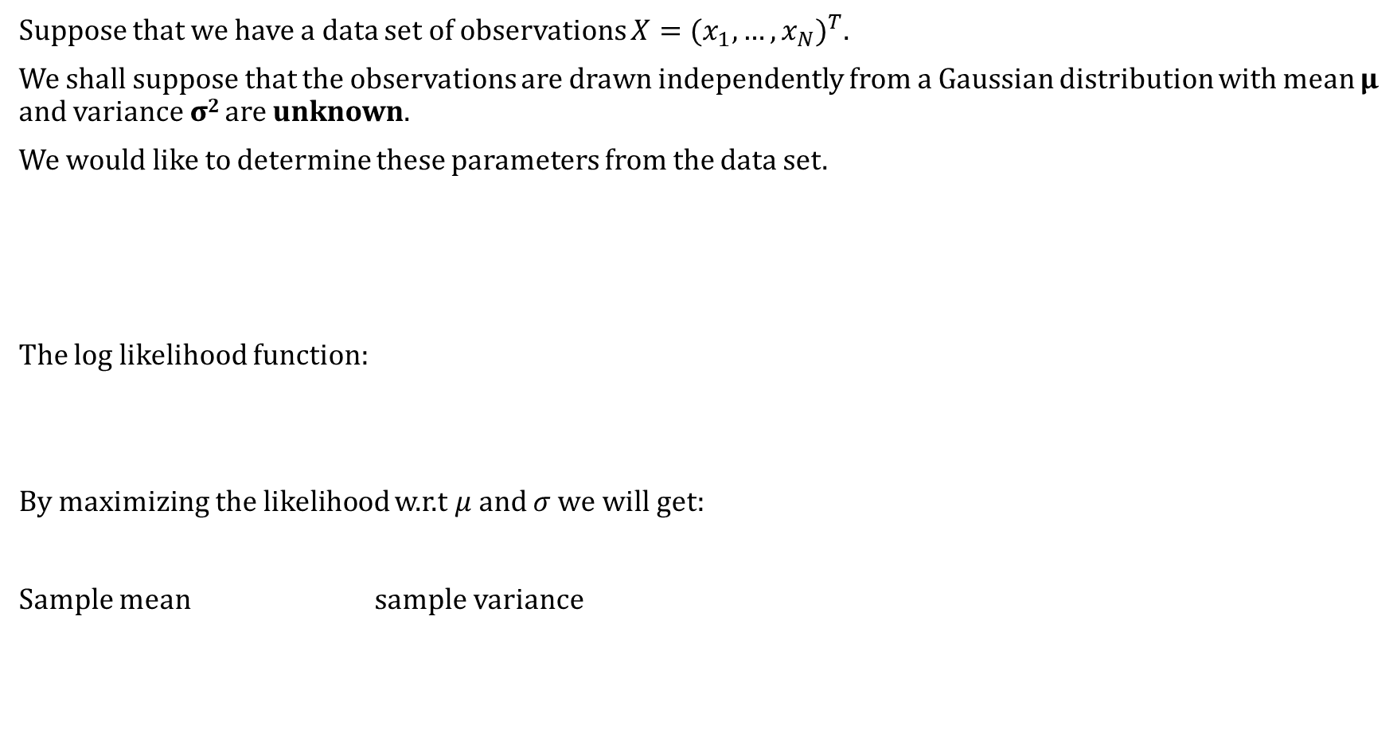
Suppose that we have a data set of observations $X={(x_{1}, …,x_{N})}^{T}.$
We shall suppose that the observations are drawn independently from a Gaussian distribution with mean μ and variance σ² are unknown.
We would like to determine these parameters from the data set.
The log likelihood function:
By maximizing the likelihood w.r.t $μ$ and $σ$ we will get:
Sample mean sample variance

Slide 23
The maximum likelihood approach systematically underestimates the variance of the distribution.
This is an example of a phenomenon called bias and is related to the problem of over-fitting.
so that on average the maximum likelihood estimate will obtain the correct mean but will underestimate the true variance by a factor (N − 1)/N.
Unbiased estimate of variance:

Slide 24
Illustration of how bias arises in using maximum likelihood
Original distribution : green line
Fit three datasets each have 2 data points.
red curves show the Gaussian distributions obtained by fitting to three data sets.
Averaged across the three data sets, the mean is correct
the variance is systematically under-estimated because it is measured relative to the sample mean and not relative to the true mean.

Slide 25
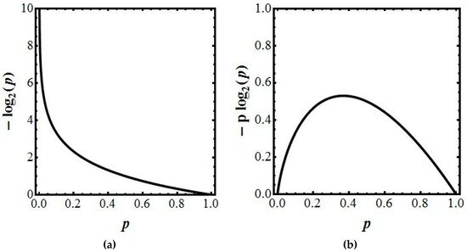
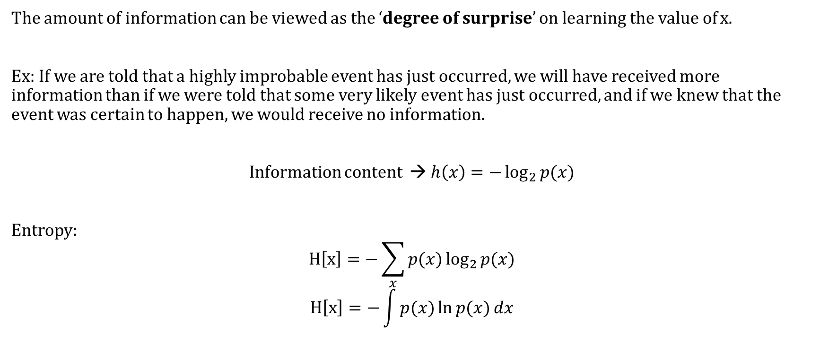
Information Theory
The amount of information can be viewed as the ‘degree of surprise’ on learning the value of x.
Ex: If we are told that a highly improbable event has just occurred, we will have received more information than if we were told that some very likely event has just occurred, and if we knew that the event was certain to happen, we would receive no information.
Information content → $h\left(x\right)=−\log_{2}{p(x)}$
Entropy:
$$H\left[x\right]=−\sum_{x}{p(x)\log_{2}{p(x)}}$$
$$H\left[x\right]=−\int{p(x)\ln{p(x)}{dx}}$$

Slide 26

Example: A variable having 8 possible states {a, b, c, d, e, f, g, h} for which the respective probabilities are given by ($\frac{1}{2},\frac{1}{4},$ $\frac{1}{8},$ $\frac{1}{16},$ $\frac{1}{64},$ $\frac{1}{64},$ $\frac{1}{64},$ $\frac{1}{64}$).The entropy in this case is given by:
Example:
Histograms of two probability distributions over 30 bins illustrating the higher value of the entropy H for the broader distribution. The largest entropy would arise from a uniform.

Slide 27
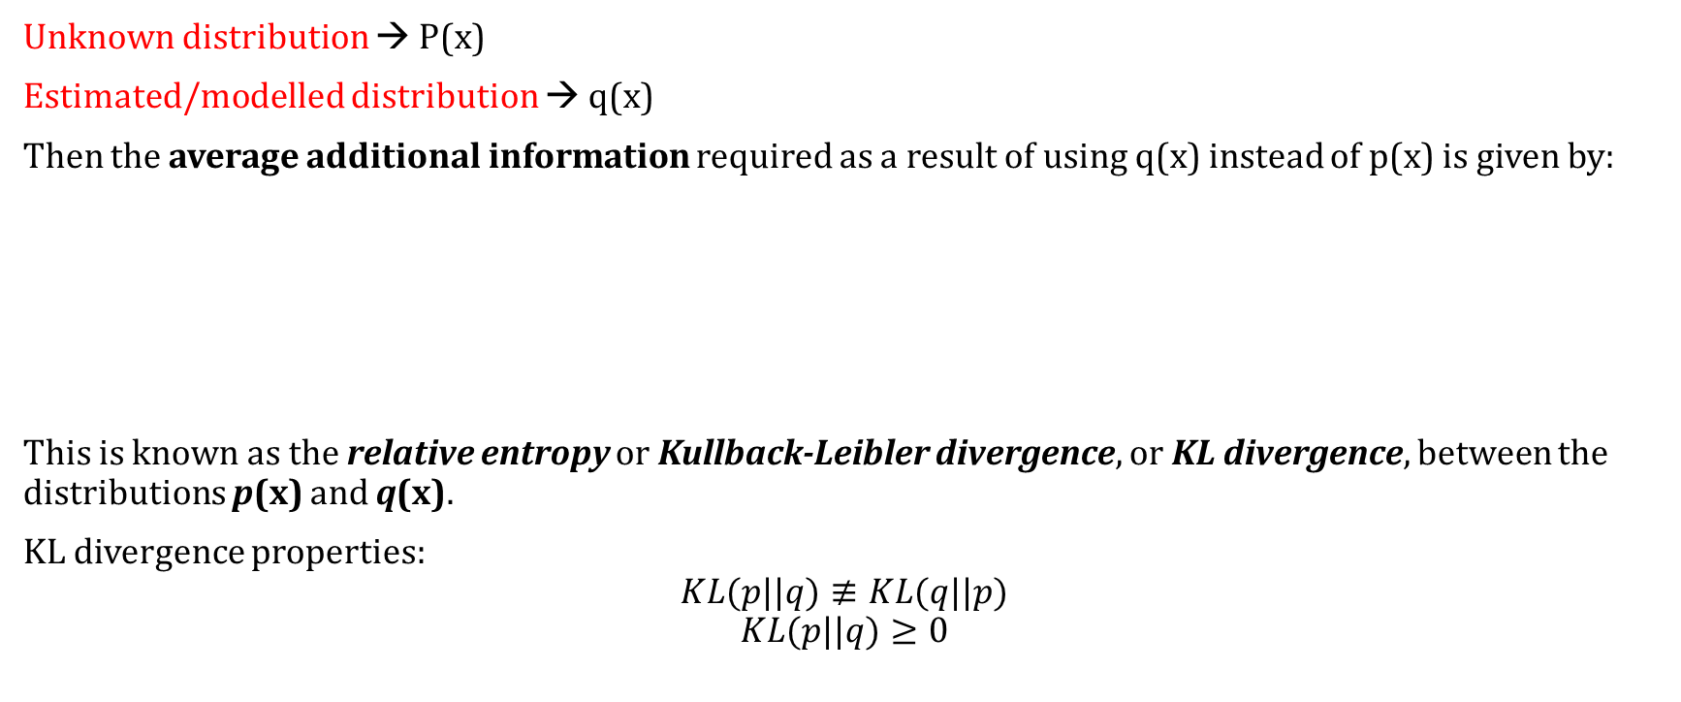
Relative entropy and mutual information
Unknown distribution → P(x)
Estimated/modelled distribution → q(x)
Then the average additional information required as a result of using q(x) instead of p(x) is given by:
This is known as the relative entropy or Kullback-Leibler divergence, or KL divergence, between the distributions p(x) and q(x).
KL divergence properties:
$$KL(p||q)≢KL(q||p)$$
$$KL(p||q)≥0$$

Slide 28
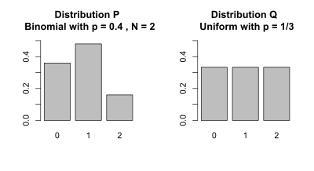
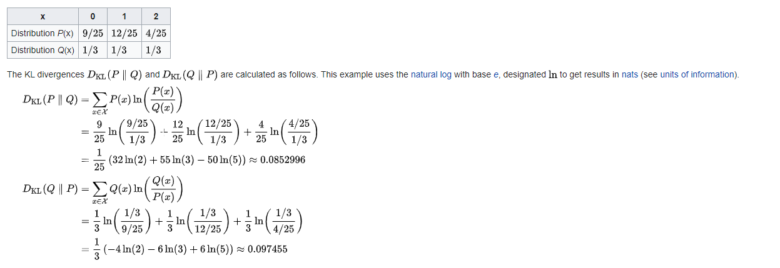
Example:

Slide 29
We can interpret the KL divergence as a measure of the dissimilarity of the two distributions p(x) and q(x).
Application: Suppose that data is being generated from an unknown distribution p(x) that we wish to model. We can try to approximate this distribution using some parametric distribution q(x|θ), governed by a set of adjustable parameters θ.
One way to determine θ is to minimize the Kullback-Leibler divergence between p(x) and q(x|θ) with respect to θ.
We can calculate the mutual information between two sets of random variables using the joint distribution.
Mutual Information =

